Slide 1
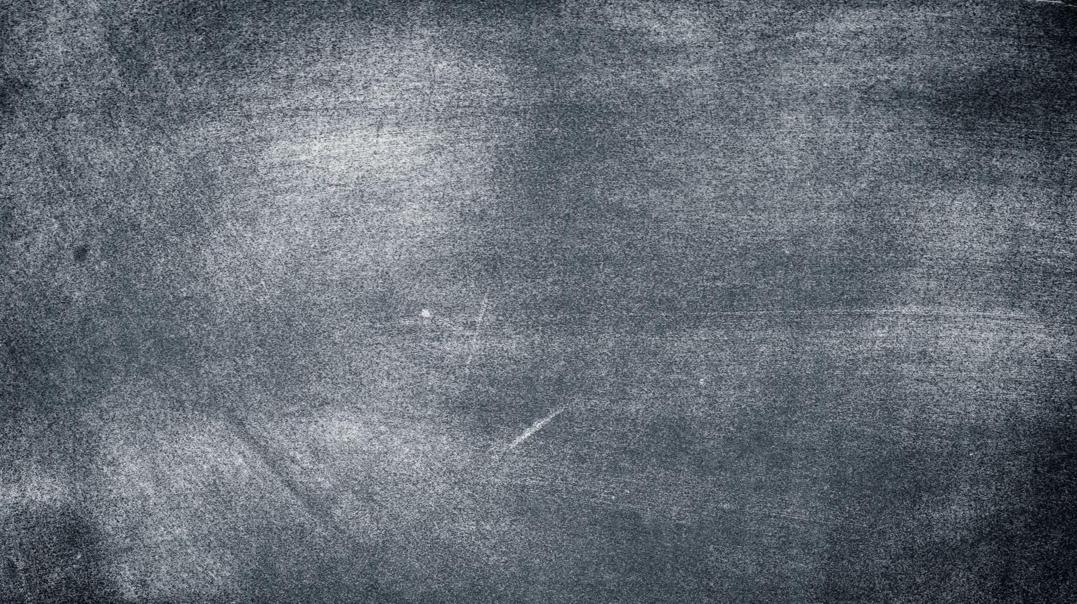
Acne Vulgaris
Kari Bernhardt RN BSN CEN DNP-S
School of Health Sciences, University of Mary
NUR 562: Pharmacology for Advanced Practice Prescribers
Dr. Billy Madler
July 27th, 2021

Slide 2
Contents
Introduction to case study
What is Acne
Pathophysiology
Diagnosis
Treatment Goals
Management
Treatment Options
Rational Drug Selection
Follow-Up

Slide 3
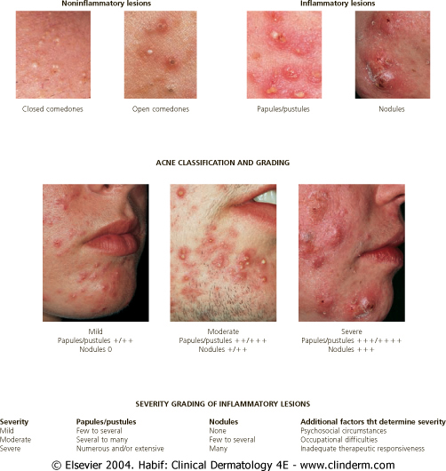
Case Study
Jane age 16
CC: “I want my face clear for prom”
Background:
  inconsistent use of Clearasil
  Cut out chocolate and greasy foods
Social History:
  Works as a fast-food restaurant after school
  Sexually Active
Physical Exam:
  Open and closed comedones
  Papules on face and back
  No evident scarring
Notes:
Jane is a 16 year old female who came to the clinic for a routine physical exam. During the exam you notice that she has acne that she is hiding under heavy makeup. She confides in your that prom is in 6 weeks and she would like her face clear for prom. She has tried Clearasil inconsistently without relief, stopped eating chocolates and greasy foods without help. She works at a fast-food restaurant after school and on the weekends. She is sexually active

Slide 4
Acne Vulgaris
Affects 50 million Americans
  3 million in healthcare costs each year
70-87% prevalence in adolescents
  Girls as young as 9-10
  Adults 20-40
Minor medical problem
  significant impact on quality of life
(Woo & Robinson, 2020)
Notes:
Acne affects on estimated 50 million Americans with a direct cost of the disease estimated to be $3 billion per year. Can occur in girls as young as 9 to10 with 70-87% prevalence in adolescents although acne can also occur in patients in their twenties to forties. Adolescent acne is more common in boys then in girls however adult acne is more common in women then men. Males have a higher incidence of severe acne at all ages.
Although acne may be a minor problem from a medical standpoint, studies have determined that acne has a significant impact on patient’s quality of life

Slide 5
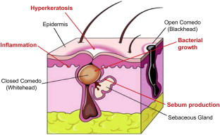
Pathophysiology
Acne Lesions
  Noninflammatory - comedones
  Inflammatory – papules, pustules, nodules, cysts
Multifactorial
  Follicular hyperkeratinization
  Excessive sebum production
  Follicular proliferation of Propionibacterium acne
  Inflammation and rupture of folic
Androgens
  PCOS
  Congenital Adrenal Hyperplasia
  Endocrine tumors
(McCance & Huether, 2019)
Notes:
Acne develops at sebaceous follicles (usually located on face and upper parts of chest and back.) Follicles have many large sebaceous glands and follicular canal visible as a pore.
Sebaceous glands are enlarged and sebum production is increased (b/c androgen hormones)
Acne Lesions
Noninflammatory - extra sebum occludes the hair follicle leading to ---open and closed comedones (black and white heads) with accumulated material causing dilation of the follicle and thinning of canal
Inflammatory – in closed comedones follicular wall ruptures expelling sebum into demis and initiating inflammation, forms pustules, papules, and cystic nodules –leads to scarring
Depending on the intensity of inflammation may have superficial papules and or pustules or deeper nodules
Multifactorial: Genetic – predisposes some people to acne, may determine an individual’s susceptibility and severity of disease
Follicular hyperkeratinization
Excessive sebum production
Follicular proliferation of Propionibacterium acne
P.Acnes colonize the follicles and convert triglycerides in the sebum into free fatty acids. Free fatty acids are a factor in the synthesis of chemoattractant that draw inflammatory elements –leading to inflammation ---this bacteria is responsible for transforming comedones into inflammatory pustules and papules
Inflammation and rupture of folic
Androgens (testosterone) synthesized in increasing amounts during puberty boosts size and productivity of sebaceous glands and promote P. acne
Results in higher levels of circulating androgens

Slide 6
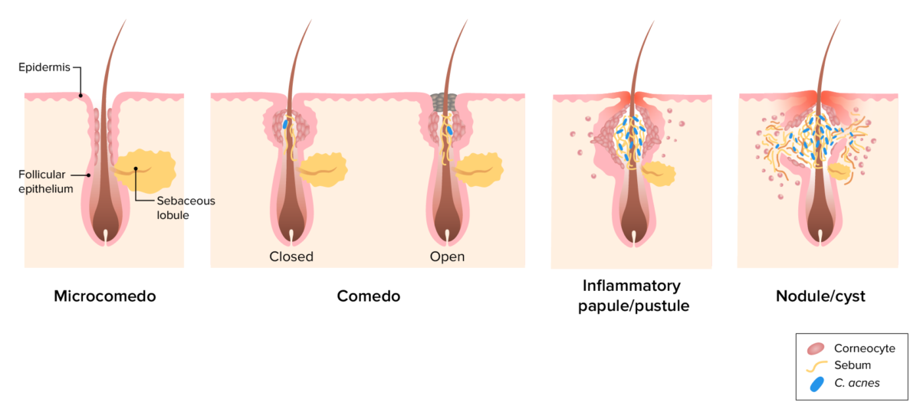
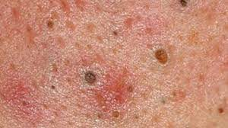
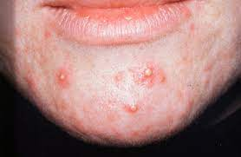
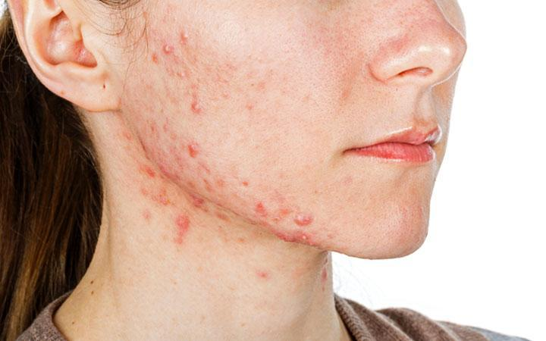
Notes:
Blackhead – pore is open and sebum accumulation has oxidized
Whitehead- sebum accumulation is covered by think layer of skin
Papule – tender, often sensitive red and pink bumps
Pustules – yellow or white with redness at the base of the swelling
Nodules – hard, tender pimples embedded deeply under the skin

Slide 7
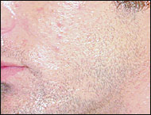
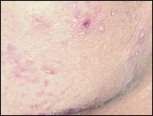
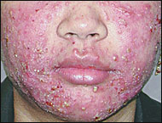
Diagnosis
Classification
Mild | Moderate | Severe
Few erythematous papules and occasional pustules mixed with comedones | Many erythematous papules and pustules as well as prominent scarring | Extensive pustules, erythematous papules, and multiple deep seated nodules within an extremely inflamed background
Based on history and physical
  Inspect face, neck, chest, upper arms, and back
Assess contributing factors
  Hormonal
  Mechanical
  Drug-related
Determine Severity
Assessment of psychosocial impact
(Feldman et al., 2004) (Ramli et al., 2011)
Notes:
Greatest concentration of sebaceous glands face, neck, chest, upper arms, and back
the existence of so many grading systems indicates a lack of consensus on this issue and hence no grading system is considered to be a global standard. All the grading systems place different emphasis on counting acne lesions as well as for comparison of the patients with a photographic standard.
the American Academy of Dermatology developed a classification scheme for primary acne vulgaris.⁷This grading scale delineates three levels of acne: mild, moderate, and severe.
Mechanical – tight fitting clothes, helmets, pillow
Drugs that cause acne- antieplipetics, antipsycotics, vitamin b

Slide 8

Treatment Goals
Individualized according to severity
Address causative factors
Minimize visible lesions
Controlling the inflammatory process
Decrease the obstruction of the sebaceous ducts
Limit scarring
(Oge et al., 2019)
(Woo & Robinson, 2020)

Slide 9
Treatment Options
Non-Pharmacological
  Physical Modalities
  Complementary therapies
Pharmacological
  Topical Agents
  Oral Agents
(Woo & Robinson, 2020)

Slide 10
Non-Pharmacological Alternative
Diet
  Low-glycemic load
  Avoidance of skim milk
Acupuncture & Cupping
Herbal medicines
  Tea tree oil
  Purified bee venom
Light Therapy / Laser Treatment
Chemical Peels
Comedo Extraction
(Oge et al., 2019)
(Rao, 2020)
Notes:
performed a study on chocolate, having teenage patients with acne consume 1 bar of chocolate each day. Some of the patients improved and some worsened, but the vast majority were unchanged.
consumption of unhealthy "junk" foods (eg, potato chips, soft drinks) has had a negative impact on general and skin health, resulting in acne flares.
Skim milk, compared with full-fat milk, has been found to have a positive association with acne, especially in teenagers and young adults (hormonal factor)
Whey protein is a commonly used supplement that has been suggested to worsen acne
high-protein, low–glycemic load diet decreased the total amount of acne lesions,
Laser and light-based modalities have been studied in the treatment of noninflammatory and moderate to severe inflammatory acne; however high-quality evidence is lacking. Photodynamic therapy has been studied most extensively.^{1,36} There is limited evidence to support chemical peels and comedo extraction for the management of comedonal acne.¹
Although of low quality, there is evidence that purified bee venom, tea tree oil, a low-glycemic-load diet, or avoidance of skim milk is associated with a reduction in skin lesions.

Slide 11
Topical Agents
Retinoids:
Use: Inflammatory and non-inflammatory acne
  Action: alter the abnormal keratinization process of acne that leads to microcomedone formation; stimumlate mitotic activity and increase the turnover of follicular epithelial cells (extrusion of comedones)
  Education: 6-8 weeks until results; initial worsening of acne
Antibiotics:
Use: Mild acne, maintenance after oral antibiotics, combination with retinoids
  Action: activity against P. acnes, control inflammatory process by reducing free fatty acids
  Education: Benzoyl products can bleach clothes and towels
Tretinoin (Retin-A) | Adapalene (Differin OTC), | Adapalene and benzoyl peroxide (Epiduo)
Benzoyl Peroxide (OTC) | Benzoyl Peroxide/ Clindamycin | Erythromycin | Benzoyl Peroxide/Erythromycin | Clindamycin | Tetracycline | Azelaic acid | Ivermectin | Metronidazole
(Woo & Robinson, 2020)
Notes:
Antibiotics: applied topically have uneven erratic penetration into the follicles

Slide 12
Oral Agents
Antibiotics
  Use: moderate to severe acne
  Action: does NOT affect existing lesions, prevent future lesion by decreasing sebaceous fatty acids & decreasing P. acne colonization
Contraceptives
  Use: mild, moderate, and severe acne
  Action: control inflammatory component
  Education: 3-6months to see effects
Retinoid
  Use: Severe, nodulocystic acne
  Only prescribed by dermatologist
Tetracycline | Minocycline | Doxycycline
Beyaz | Gianvi | Loryna | Nikki | Yaz
Isotretinoin (Accutane)
(Woo & Robinson, 2020)
Notes:
Antibiotics: level one evidence for the use of tetracycline, doxycycline, minocycline. Azithromycin effect but routine use leads to resistance. Increased resistance to erythromycin

Slide 13
Non-traditional approach
Antiandrogens
  Spironolactone
  Flutamide
Corticosteroids
  Prednisone
(Oge et al., 2019)
Notes:
There are limited studies demonstrating the effectiveness of spironolactone (aldosterone receptor antagonist) and flutamide (androgen receptor blocker) in the treatment of acne
recommends the use of spironolactone for its antiandrogenic properties in women with resistant and hormonally mediated acne.
Spironolactone should be used in conjunction with contraception because of the risk of fetal antiandrogenic effects.
the use of flutamide because of the potential for serious adverse effects.^{1,35} Breast tenderness, menstrual irregularities, and hyperkalemia may occur in patients treated with spironolactone.
Prednisone (5 mg to 15 mg daily) has demonstrated effectiveness in the treatment of acne and may be used as an adjunct in select patients; however, the potential adverse effects limit its use.
like eruptions in patients initiating isotretinoin, treatment of severe nodulocystic acne in pregnancy (after the first trimester),

Slide 14
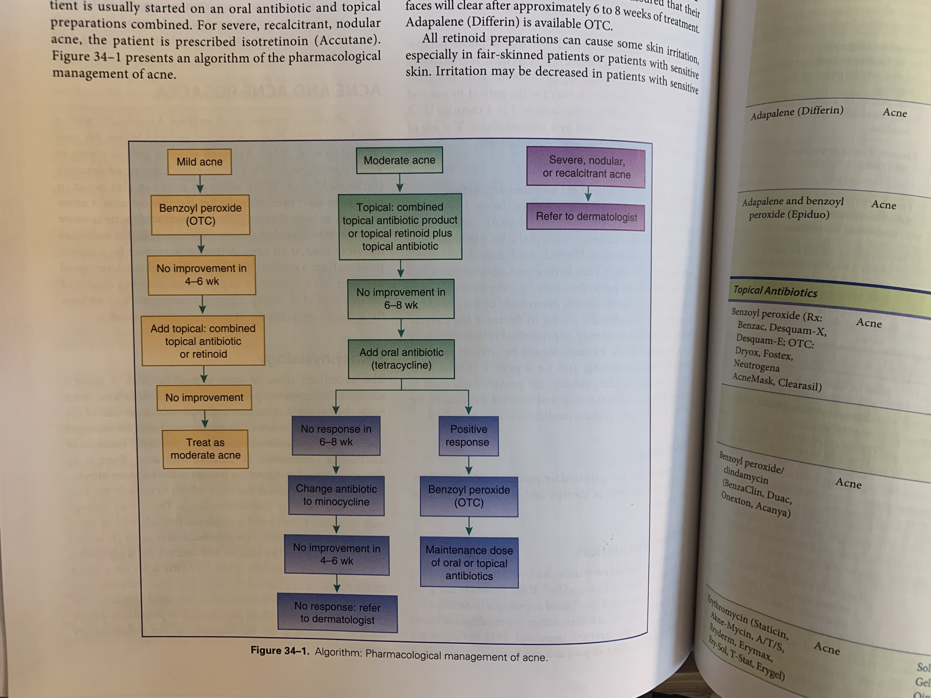
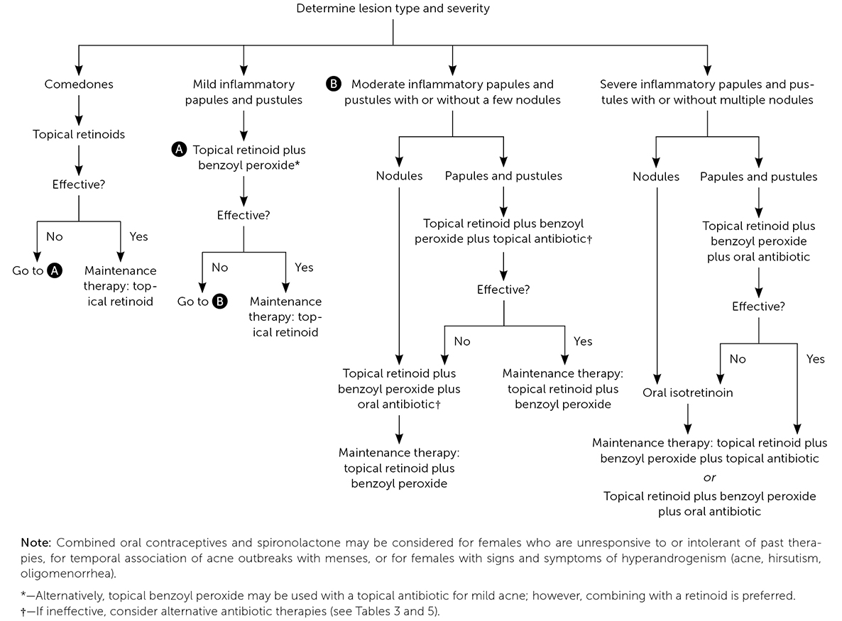
Rational Drug Selection
(Woo & Robinson, 2020)
(Oge et al., 2019)
Notes:
According to the algorithm for mild-moderate acne, the first step is Benzoyl peroxide which the patient has been using inconsistently (the main ingredient in clerasil is BP) if no improvements in 4-6 weeks can add a topical agent like a retinoid. Topical Retinoid plus benzoyl peroxide monitor for 4-6 weeks follow-up in clinic
Benzoyl Peroxide. Benzoyl peroxide is comedolytic, anti-inflammatory, and bactericidal against C. acnes.¹⁵Benzoyl peroxide is available over the counter and by prescription in multiple strengths and formulations, and can be used alone or in combination with topical antibiotics or retinoids.
In the treatment of acne, the vehicle (cream, gel, lotion or solution) may be as important as the active agent. Consequently, it is important to assess the patient's skin type.
Creams are appropriate for patients with sensitive or dry skin who require a nonirritating, nondrying formulation. Patients with oily skin may complain of an “oily” feel with creams.
Patients who have oily skin may be more comfortable with gels, which have a drying effect. However, gels may cause a burning-type irritation in some patients and may prevent certain kinds of cosmetics from adhering to the skin.
Lotions can be used with any skin type, and they spread well over hair-bearing skin. Yet lotions contain propylene glycol and thus may have burning or drying effects.
Solutions are mainly used with topical antibiotics, which are often dissolved in alcohol. Like gels, solutions work best in patients with oily skin.

Slide 15
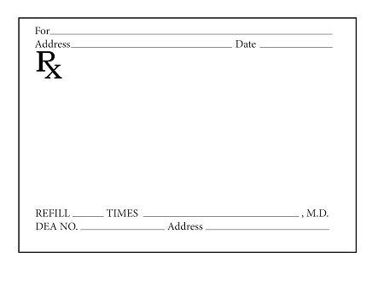
Rx for jane
Pharmacodynamics
Pharmacokinetics
ADR
Interactions
Contraindications/Cautions
Topical Tretinoin Cream 0.025%
Apply to affected areas once daily after washing face
1
K.Bernhardt DNP-S
(Woo & Robinson, 2020)
Notes:
Has been using clerisil inconsistently – main ingredient is benzoyl peroxide: Continue to use the clerisil in the AM and PM (face wash)
Benzoyl Peroxide. Benzoyl peroxide is comedolytic, anti-inflammatory, and bactericidal against C. acnes.¹⁵Benzoyl peroxide is available over the counter and by prescription in multiple strengths and formulations, and can be used alone or in combination with topical antibiotics or retinoids.
USE: Combination therapy is often employed when patients have a mixture of comedonal and inflammatory acne lesions.
Mechanism of action – binds to retinoic acid receptors, stimulating epithelial cell turnover
Metabolism – skin
Excreted – urine
ADR - (common) peeling, burning, stinging, blistering, photosensitivity
Interactions – skin irritants/drying agents, photosensitivity
Contraindications/Cautions: caution with eczema, sunburn, 1st trimester of pregnancy

Slide 16
Rx for Jane
Pharmacodynamics
Pharmacokinetics
Interactions
Contraindications/Caution
ADR
Drospirenone/ethinyl estradiol (Nikki) monophasic 28-day (3mg/20mcg tab X24; inert tab X4 )pack, PO qd
Start day 1 of menstrual cycle or 1st Sunday after onset of menses
3
K.Bernhardt DNP-S
(Woo & Robinson, 2020)
Notes:
There are currently four combined oral contraceptives approved for the treatment of acne vulgaris
Ensure patient is NOT PREGNANT
Urine test
No intercourse since last menses
Within first 7 days of her menses
Use should be considered for menarchal females unresponsive or intolerant to past therapies, for temporal association of acne outbreaks with menses, or for females with signs and symptoms of hyperandrogenism (acne, hirsutism, oligomenorrhea).
Contraceptive- monophasic: estrogen/progestin OCP
Monophasic pack (same dose of estrogen and progestin for each active pack) : 28 day pack 3mg/20mcg tab X24; inert tab X4
Action: suppresses LH and FSH, inhibiting ovulations, alters cervical mucus and endometrium ---ACNE: decreases androgenicity (reduces carb and lipid metabolism lessening acne)
Metabolism: liver and GI tract, excreted in feces and urine
Interactions: hyperkalemia, thrombogenic effects, hypertensive effects, thyroid hormone synthesis
Contraindications/Cautions: estrogen-progestin dependent cancers, history of breast or endometrial cancer; renal/hepatic impairment, thromboembolism, migraine, SLE
Caution with depression, DM, HTN, gallbladder disease, hyperlipidemia
ADR: thrombosis, MI, Stroke, HTN, depression (serious)
(Common) bleeding irregularities, breast tenderness, headaches, weight changes, irritability, emotional lability, n/v

Slide 17
Drug Surveillance
Topical Tretinoin
  No routine testes recommended
    Monitor: redness and peeling of skin
Nikki
  Glucose if diabetes
  Lipid panel if hyperlipidemia
  Blood pressure if hypertension
  Renal function if impairment present
(Woo & Robinson, 2020)

Slide 18
Education
Topical Tretinoin Cream
Nikki
  Wash hands after application
  Non-comedogenic products
  Avoid other topical irritative substances
  Avoid around eyes and mucous membranes
  Not safe for pregnancy
  Increased photosensitivity
  Expected side effects
  Worsen acne initially
Backup contraception
STI prevention
Breakthrough bleeding
Monitor ADR
(Woo & Robinson, 2020)
Notes:
Pregnancy category C – pregnant women should be switched to another product
May cause some skin irritation – decrease use to three times a week or every other day and increase to daily use as tolerated
Avoid using harsh toners, astringents, scrubs, or cleansers – may cause more irritation
Increased photosensitivity – use a noncomedogenic sunscreen for any sun exposure
Expected side effects --- burning, stinging, itching, redness, and peeling with excessive application

Slide 19
Patient Follow-up
Have the goals been met?
Follow-up visit 2-3months
Consider dermatologist referral
(Oge et al., 2019)
(Feldman et al., 2004)
(Woo & Robinson, 2020)
Notes:
Goal: see a reduction in comedonal and inflammatory lesions, improvement in psychosocial symptoms, and avoidance of scarring
Follow-up visit 2-3months : Minimum duration of eight weeks to assess effectiveness unless pt has an allergy or experience intolerable adverse effects
Consider dermatologist referral – if the patient should inadequate improvement after sequential interventions; The patient who has not responded to treatment as expected may need to be referred to a dermatologist.

Slide 20
Discussion Questions
Does anybody have an personal experience with acne treatment?
Thoughts on oral contraceptives for the treatment of acne?

Slide 21
References
Feldman, S., Careccia, R. E., & Barham, K. L. (2004). Diagnosis and treatment of acne. American Family Physican, 69(9). https://doi.org/https://www.aafp.org/afp/2004/0501/p2123.html
McCance, K. L., & Huether, S. E. (2019). Pathophysiology: The biological basis for disease in adults and children (8th ed.). Elsevier .
Oge, L. K., Broussard, A., & Marshall, M. D. (2019). Acne vulgaris: Diagnosis and treatment. American Family Physician, 100(8). https://doi.org/https://www.aafp.org/afp/2019/1015/p475.html#afp20191015p475-f1
Ramli, R., Malik, A., Hani, A., & Jamil, A. (2011). Acne analysis, grading and computational assessment methods: An overview. Skin Research and Technology, 18(1), 1–14. https://doi.org/10.1111/j.1600-0846.2011.00542.x
Rao, J. (2020, August 28). Acne vulgaris treatment & management: Medical care, surgical care, consultations. Medscape. https://emedicine.medscape.com/article/1069804-treatment
Woo, T. M., & Robinson, M. V. (2020). Pharmacotherapeutics for advanced practice nurse prescribers (5th ed.). F. A. Davis Company.

